Slide 1
Developer Training
Monetization

Slide 2
Agenda
Customers and Use Cases
Stability
Scalability
Overview
Features
Takeaways

Slide 3
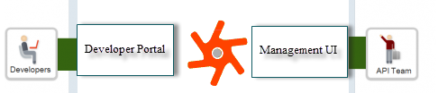
Introduction
Easy-to-use and flexible way to monetize your APIs so that you can generate revenue for the use of those APIs.
http://apigee.com/docs/monetization/content/basics-monetization

Slide 4
Monetization Use Case
Consider a typical telecom provider who has 3 apis
Payment : An api which allows to make a payment to provider
Messaging : An api to send text messages
Location : An api which would return lattitude/longitude of any given user

Slide 5
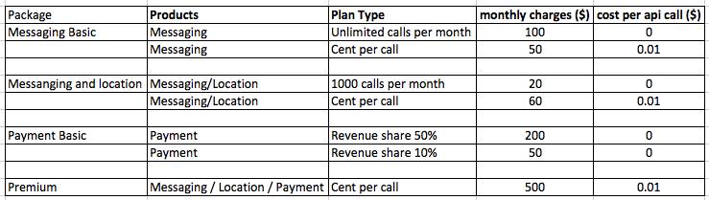
Monetize API Use Case
Now that provider has 3 apis and many developers, api provider wants to monetize these apis
Payment : Provider wants to give a % share of payment made by user
Messaging : Charging a developer for every api call
Location : Charging a developer for every api call

Slide 6
Where to Start Monetizing?
After you purchase monetization, the Apigee configuration team will do the initial monetization setup and you will find it integrated with Edge Managment UI
The Apigee configuration team also runs a script that synchronizes with monetization your organization and any developers, applications, and products that you created using the Edge API Services. After a period of time (such as a few months) and periodically after that, it's advisable to re-synchronize your organization with monetization, and any developers, applications, and products that you created using Edge API Services. See Synchronize Apigee Edge data with monetization for details.
http://apigee.com/docs/monetization/content/set-monetization

Slide 7
Implementation Steps
Apigee support/ops
API Provider (Customer)
Tax engine configuration (sabrix)
Billing run scheduler
Default notification configurations
Synchronize developers/apps
Worldpay Integration (Customer interaction required)
http://apigee.com/docs/monetization/content/set-monetization
Organization Profile
Billing Document configuration
Configure transaction recording policies
Create api packages
Create rateplans
Assign developer categories if applicable
Setup limits
Setup notifications
http://apigee.com/docs/monetization-services/content/get-started-using-monetization

Slide 8
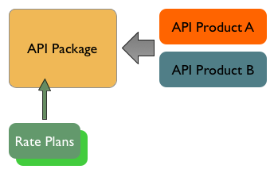
API Package
An API package (also called a monetization package) is a collection of API products that is presented to developers as a bundle, and typically associated with one or more rate plans for monetization. Think of API packages as the revenue generating parts of your product line available to developers.
http://apigee.com/docs/monetization/content/basics-monetization

Slide 9
Terminologies
ApiProduct : You all should know already :)
The API product is the mechanism through which your APIs are bundled and published so that developers can consume them.
Transaction recording policy : enables monetization to capture transaction parameters and custom attributes. Monetization needs this information to perform its monetization processing such as applying rate plans to API requests and responses.
API package : is a collection of API products that is presented to developers as a bundle, and typically associated with one or more rate plans for monetization.
Rate plan : specifies the monetization approach for your API package or for individual API products in the package. For example, it specifies whether you charge for the use of your API package and products based on a flat rate or a variable rate, and whether there are additional fees.
Limits : You can set monetization-related limits. For example, you can limit the number of transactions on an API product, set an upper limit on the amount of credit that can be issued to developers, or specify a lower limit on the balance that a developer must maintain for purchasing API products.
Notifications : Monetization enables you to set up automatic notifications so that you can alert developers about events such as new products, new versions of T&C's, or new rate plans.
http://apigee.com/docs/monetization/content/set-monetization#what-you-need-to-set-up

Slide 10
Customers
12 customers as of now, 3 new customers in past 3 months
Load ranges from 0.2TPS to >2000TPS(5 months ago) >10000TPS
More than 40k developers using system
Mapquest, Ordnance, TMobile, TomTom, Pitney Bowes, Everything Everywhere, Indix, Swisscom, SaS institute, PointClickCare, Dnb, etc

Slide 11
Stability
In the past 6 months we had 6 P1s and only 1 is reported by customers all other ones are internal P1s captured by alerting and monitoring systems. All 5 we solved P1s before customer even noticed.
Availability of monetization product for past 6 months is 99.99%
Notes:
P1ss, Availabitlity

Slide 12
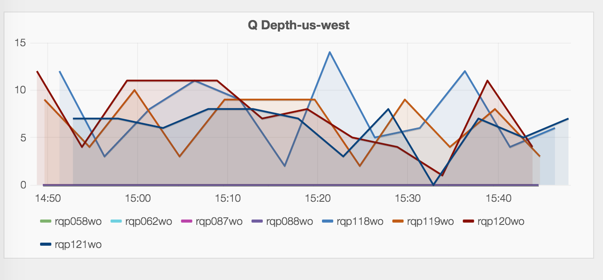
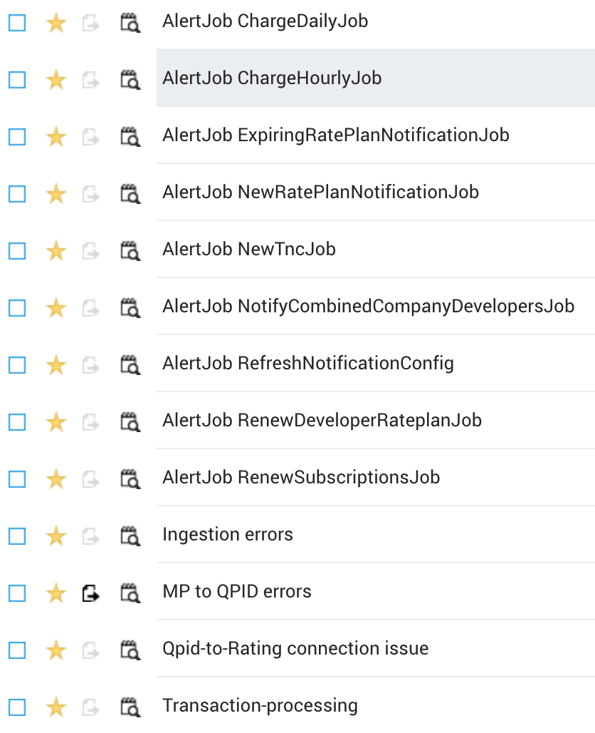
Stability
We use heavily Sumo Logic and Grafana to monitor the system.
Weekly on-call schedule by PagerDuty with all the critical alerts to be notified to on-call person.
Notes:
Monitoring https://samr.apigee.net/dashboard/db/mint_qpid

Slide 13
Scalability
Each Component can be Scale Up and Down
All Components except PostgreSQL are horizontally scalable
In case we experience outage we
recover data from UAP. We have
tools built for this. Customer will
not lose a single penny.
Notes:
Scale UP and Down of the architecture, Current TPS, show grafana traffic, show DB

Slide 14


Overview
API Provider / Business
Developer/Partner
Edge customers with requirements:
Rate and Enforce rules on APIs
Track Balance
Trigger Events (Email, Block, Renew)
Integrate with third-party Billing and Revenue Systems
End to end Developer Experience (Developer Portal) to consume, track, view and analyze Monetized APIs
Business Reporting and Analytics integrated into Edge
Production environment decoupled with Monetization Setup
API Provider Profile
Developer Profile
Catalog &
Plan Configuration
User Role Management
Purchased
Plan
Billing Type (Prepaid & Postpaid)
Management & Integration
Billing Type (Prepaid & Postpaid)
Balance Management
Billing
Documents
Billing Documents
Reports
Reports
Limits & Notifications
Limits & Notifications
Notes:
t

Slide 15
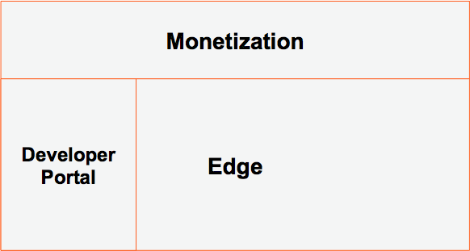
Overview
How does Monetization fit in Edge
Notes:
t

Slide 16
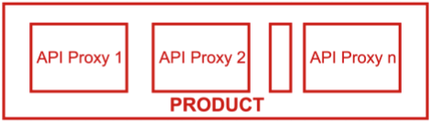
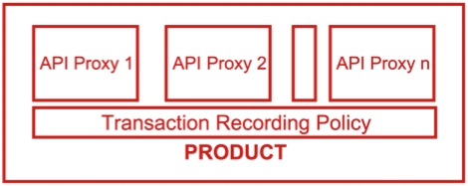
Overview
Monetization setup for runtime traffic
Before Monetization After
Notes:
t

Slide 17
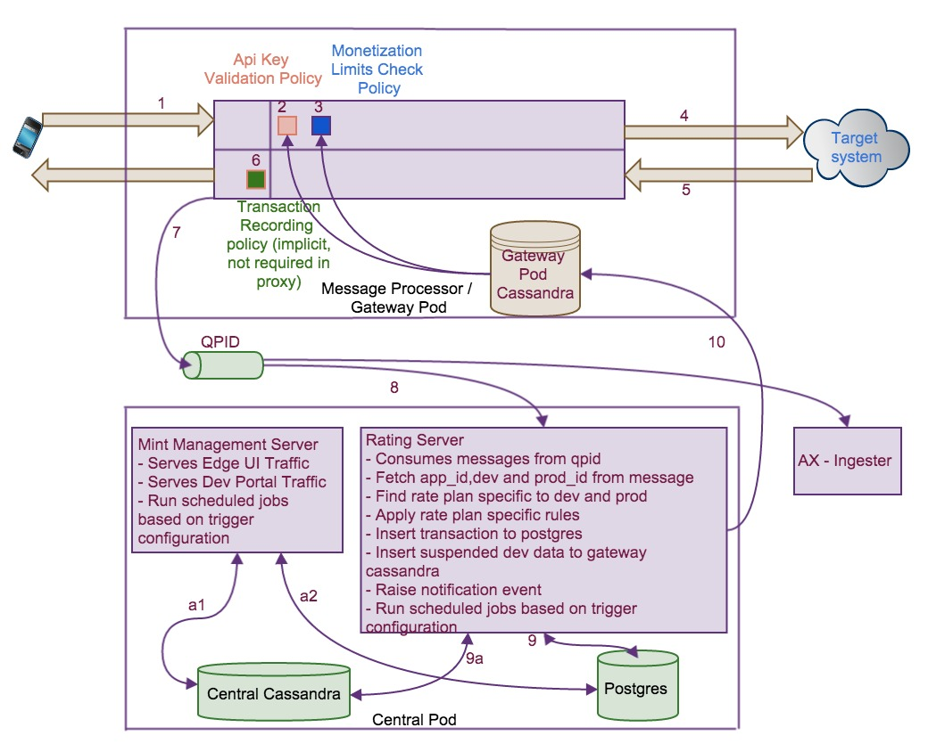
Traffic/data flow and Rating

Slide 18
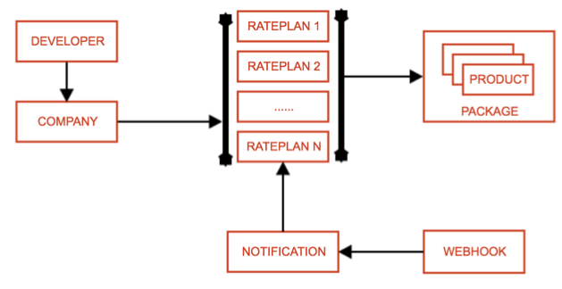
Model Entities
Model
Notes:
t

Slide 19
Model Types
Revenue-sharing models
(API provider pays developer)
Fee-based models
(API provider charges developer)
Freemium models
Notification Only models
Fixed
Transaction
Duration
Adjustable
Transaction Volume
Quantity
Flexible
Custom Attribute
Hybrid
Revenue / Volume Bands
Hybrid
(flat fee plus fixed or flexible)
One-time
Subscription
Advance / Arrears
Pro-rated / Full amount
Notes:
t

Slide 20
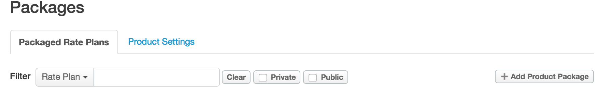
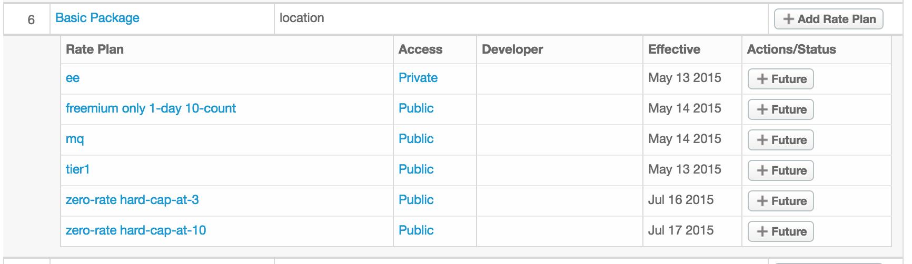
Features: Public/Private Rate Plans
Notes:
UseCase:
-A customer has rateplans that are designed only for Enterprise Customers and should not be displayed for Self-Serv developers.
-Customer still in the process of defining/approving RatePlans. Those rate plans are hidden till org approves and make them available.
-Customer wants to create a RatePlan that is developer specific or developer group specific and control it manually for start.
Ability to hide/show rate plans on developer portal.
http://docs.apigee.com/monetization/content/create-rate-plans#public-versus-private-rate-plans

Slide 21
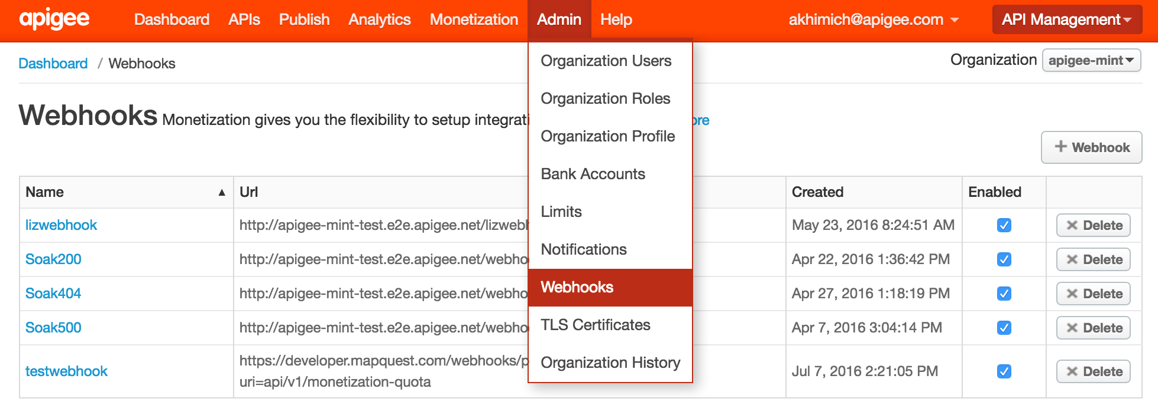
Features: Webhooks
Monetization only
Notes:
http://docs.apigee.com/monetization/content/set-up-notification-webhooks

Slide 22
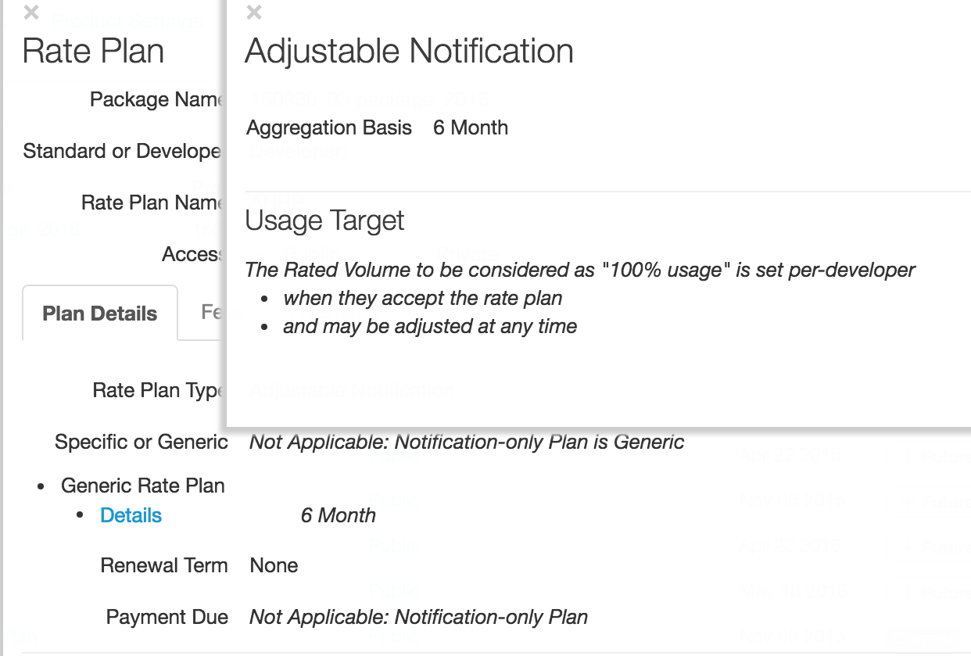
Features: Quota Targets
Each Developer has
personal Quota Target
E.G.
Ford 100M
Tesla 1M
Notes:
In an adjustable notification plan, the API provider can adjust the target number of transactions for each app developer. You can configure if and when notifications are sent based on when a percentage of the target number is reached, such as 90%, 100%, or 150%. Additional transactions are not blocked after the target number is reached.
http://docs.apigee.com/monetization/content/specifying-adjustable-notification-plan-details

Slide 23
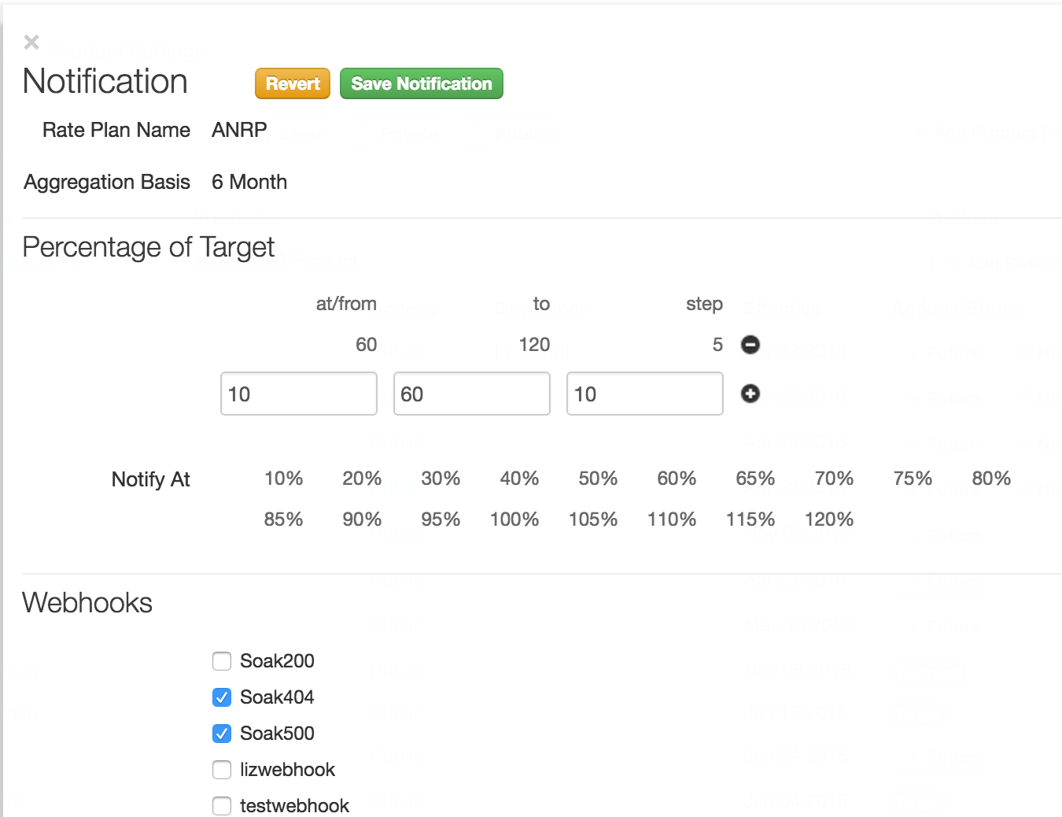
Features: Quota Targets
Each Developer has
personal Quota Target
E.G.
Ford 100M
Tesla 1M
Notification are set per
rate plan
(right now only webhooks)

Slide 24
Features: Migrating Developers and Traffic
Use case setup:
Customer has existing system were usage have been tracked, onboarding developers and usage to Apigee requires transferring usage to monetization as well with zero downtime.
Edge allows today to onboard traffic and developers, monetization allows to transfer contractual data too.
http://docs.apigee.com/monetization/content/migrating-developers-monetization
Notes:
List the features

Slide 25
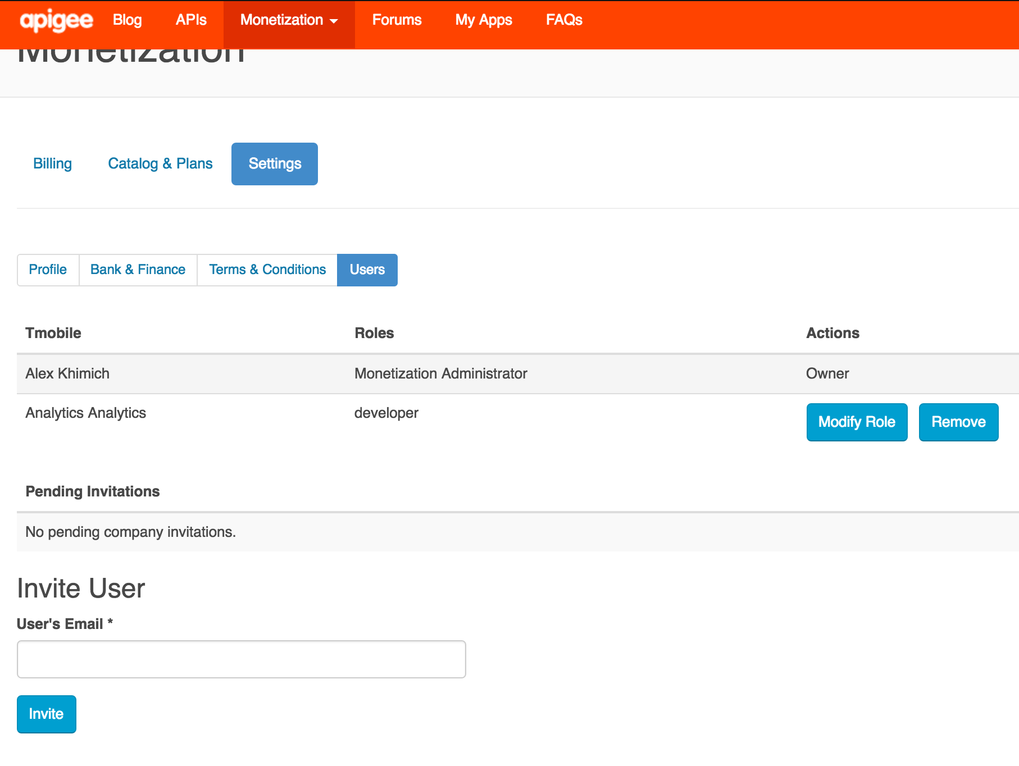
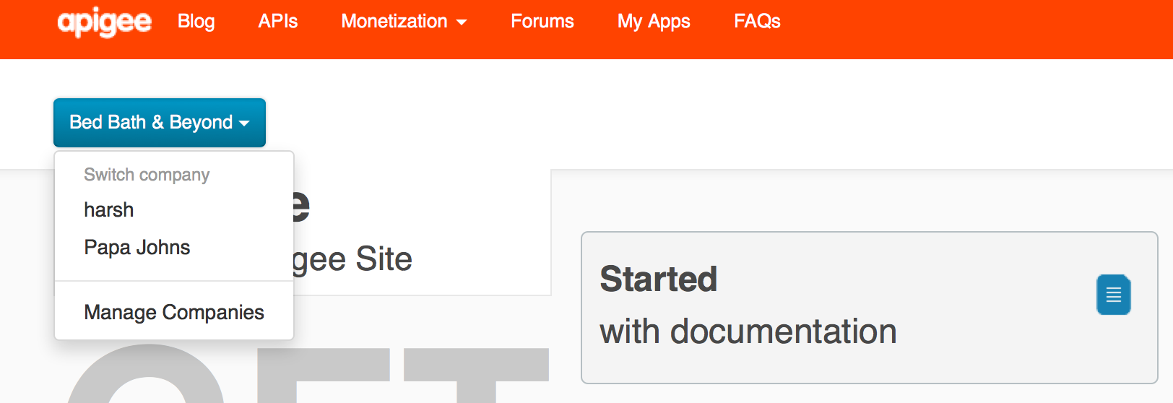
Features: Company-Developer
Company-Developer feature in monetization is for developers to share company’s quota and group developers.
Notes:
Managing the companies and developers participating in your monetized API ecosystem could be time consuming if you had to do it all yourself as an API provider. There are profiles to manage, bank, tax, and billing details to maintain, roles to assign, and so on.
The developer portal allows those management tasks to be handled by the companies and developers themselves while giving you full visibility into the ecosystem from the management UI and API.
http://docs.apigee.com/monetization/content/companies-developers-self-service
http://docs.apigee.com/monetization/content/companies-and-developers-manage-manually

Slide 26
Features: Company-Developer
Regular Companies-Developer setup
Requires Application to be created at Company level.
Company Application
Developer A
Developer B
Developer C
Rate Plan ,Quotas, Notifications are at company level
Notes:
Managing the companies and developers participating in your monetized API ecosystem could be time consuming if you had to do it all yourself as an API provider. There are profiles to manage, bank, tax, and billing details to maintain, roles to assign, and so on.
The developer portal allows those management tasks to be handled by the companies and developers themselves while giving you full visibility into the ecosystem from the management UI and API.
http://docs.apigee.com/monetization/content/companies-developers-self-service
http://docs.apigee.com/monetization/content/companies-and-developers-manage-manually

Slide 27
Features: Company-Developer
Combined Notification for Company-Developer at ANRP rate plan
You can add/remove developer to the company’s quota without refactoring applications and keys.
As soon as you added Developer to the company all developer’s usage will be counted against company’s quota
Company
Developer Application A
Rate Plan ,Quotas, Notifications are at dev level
Developer Application B
Rate Plan ,Quotas, Notifications are at dev level
Developer Application C
Rate Plan ,Quotas, Notifications are at dev level
Rate Plan ,Quotas, Notifications are at company level E.G.10MM
Notes:
Managing the companies and developers participating in your monetized API ecosystem could be time consuming if you had to do it all yourself as an API provider. There are profiles to manage, bank, tax, and billing details to maintain, roles to assign, and so on.
The developer portal allows those management tasks to be handled by the companies and developers themselves while giving you full visibility into the ecosystem from the management UI and API.
http://docs.apigee.com/monetization/content/companies-developers-self-service
http://docs.apigee.com/monetization/content/companies-and-developers-manage-manually

Slide 28
Features: Test your setup
Monetization provides a set of APIs that you can use to test your setup. Specifically, you can:
Test the execution of webhooks to ensure notifications are being sent
Review and reprocess notifications sent
View the status of transactions
Notes:
http://docs.apigee.com/monetization/content/testing-monetization

Slide 29
Takeaways
System is very stable and scalable
High level of customization is allowed
Decent Self-Service features and ecosystem
Establishing as default API-commerce platform in the industry

